Slide 1
SMART RETAIL ANALYTICS FOR FASHION SALES
Name : HEMALA R
Mentor : PANKAJ DOUNDEY

Slide 2
TABLE OF CONTENTS
Use Case
Project Focus
Project Objectives
Functional Diagram
Tools and Technologies
Technical Diagram
Dataset
Data Modeling
Key Performance Indicators
Business Impact and Value Delivered

Slide 3
Use Case Study
Fashion retailers – especially those operating in an ethnic and lifestyle segment similar to FabIndia – run both physical stores and online sales channels. However, their current operational ecosystem is still heavily dependent on :
POS billing systems in stores
Manual or semi-automated inventory tracking
Periodic Excel-based sales and stock reports
While online channels provide better analytics, offline stores continue to lack real-time visibility into critical business metrics such as:
Which product, sizes or colors are selling fast
Which items are underperforming or stagnating
Real-time stock availability across locations
As a result, retailers often struggle to build a unified view of overall business performance across online and offline channels. Decisions around procurement, replenishment, pricing, and promotions continue to rely more on intuition and experience rather than integrated, data-driven insights.

Slide 4
Project Focus
This project aims to build a unified analytics solution that integrates offline POS sales and online e-commerce data for fashion retailers.
The focus is to provide real-time insights into product performance, inventory movement, and store/employee productivity. By automating data analysis, the project enables accurate, data-driven decisions in merchandising and operations.

Slide 5
Project Objectives
Centralized Data Ingestion
Automated Data Transformation
Sales Performance Analysis
Inventory Monitoring & Optimization
Customer Segmentation & Behavior Analysis
Promotion & Discount Effectiveness Tracking
Employee & Store Performance Evaluation
Interactive Business Intelligence Dashboards

Slide 6






Functional Diagram
FabIndia Fashion Store
Collect Online & Offline
Data Daily
Process and Analyze Data
KPIs & Insights
Data Driven Decisions
Online Sales

Slide 7
TOOLS AND TECHNOLOGIES
Phase | Azure Tool
Data Ingestion | Azure Data Lake Gen2
Orchestration | Azure Data Factory
Data Processing | Azure Databricks
Data Warehouse | Azure Synapse
Visualization | Power BI

Slide 8
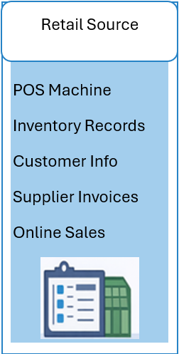
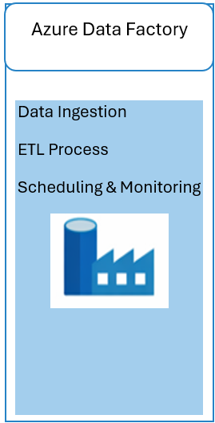
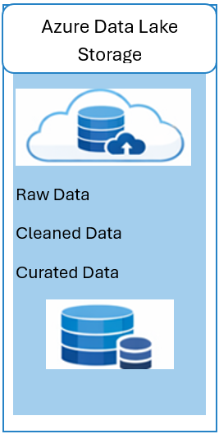
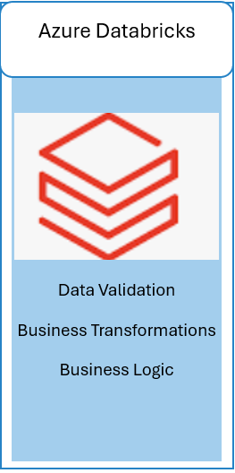
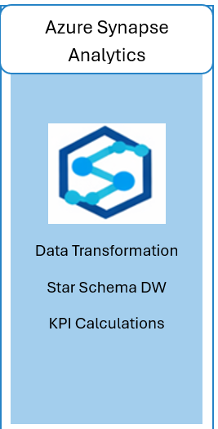
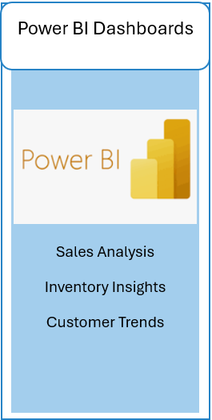
Technical Diagram

Slide 9
DATASET
The dataset is divided into fact table and multiple dimension tables.
Fact_Sales → In-store sales transactions.
Fact_Sales_Online → Online sales transactions.
Fact_Returns → Returned sales records.
Fact_Expenses → Operational expense data.
Dim_Branch → Branch location details.
Dim_Customer → Customer profile data.
Dim_Date → Calendar and time attributes.
Dim_Order → Order-level information.
Dim_Customer_Segment → Customer classification groups.
Dim_Size → Product size reference.

Slide 10
DATASET
Dim_Store → Store master details.
Dim_Supplier → Supplier information.
Dim_Product → Product master data.
Dim_Employee → Employee details.
Dim_Promotion → Promotion details.
Dim_Fabric → Fabric type reference.
Dim_Channel → Sales channel types.
Dim_Inventory → Stock level records.
Dim_Payment_Method → Payment mode types.
Dim_Return_Reason → Return reason categories.

Slide 11
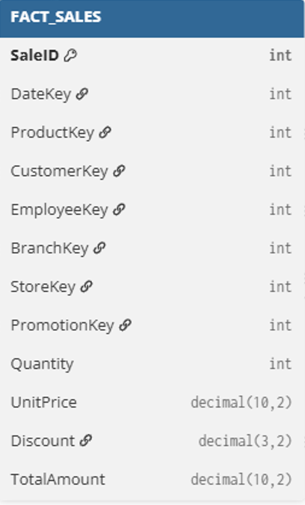
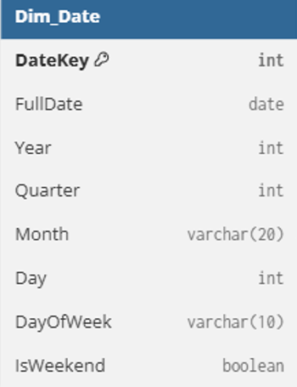
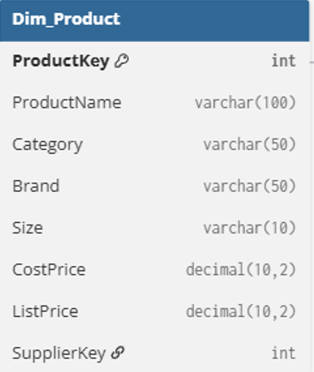
FACT AND DIMENSIONS TABLES

Slide 12
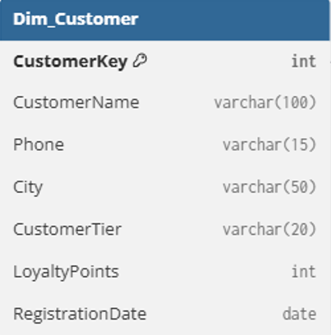
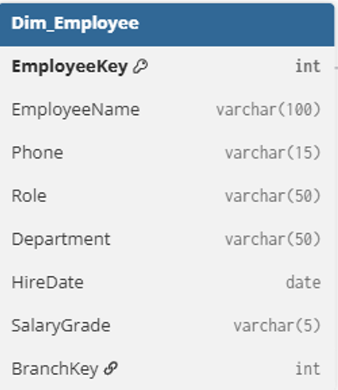
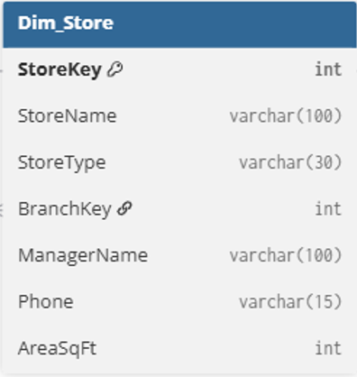
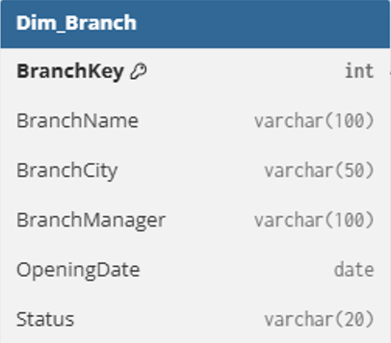
DIMENSIONS TABLES

Slide 13
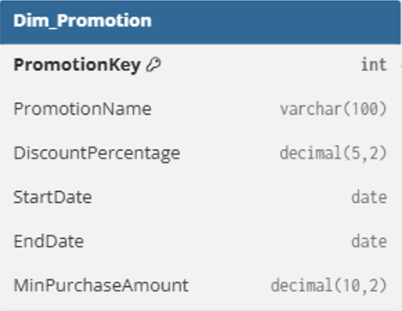
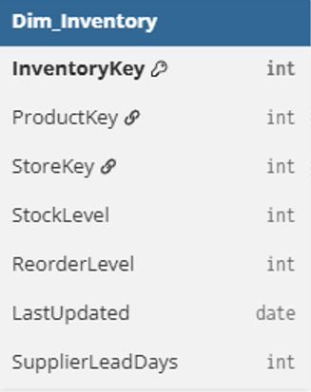
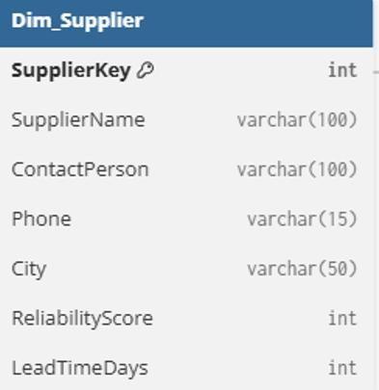
DIMENSIONS TABLES

Slide 14
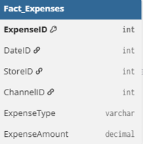

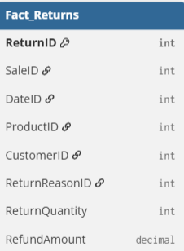

FACT AND DIMENSIONS TABLES

Slide 15





FACT AND DIMENSIONS TABLES

Slide 16
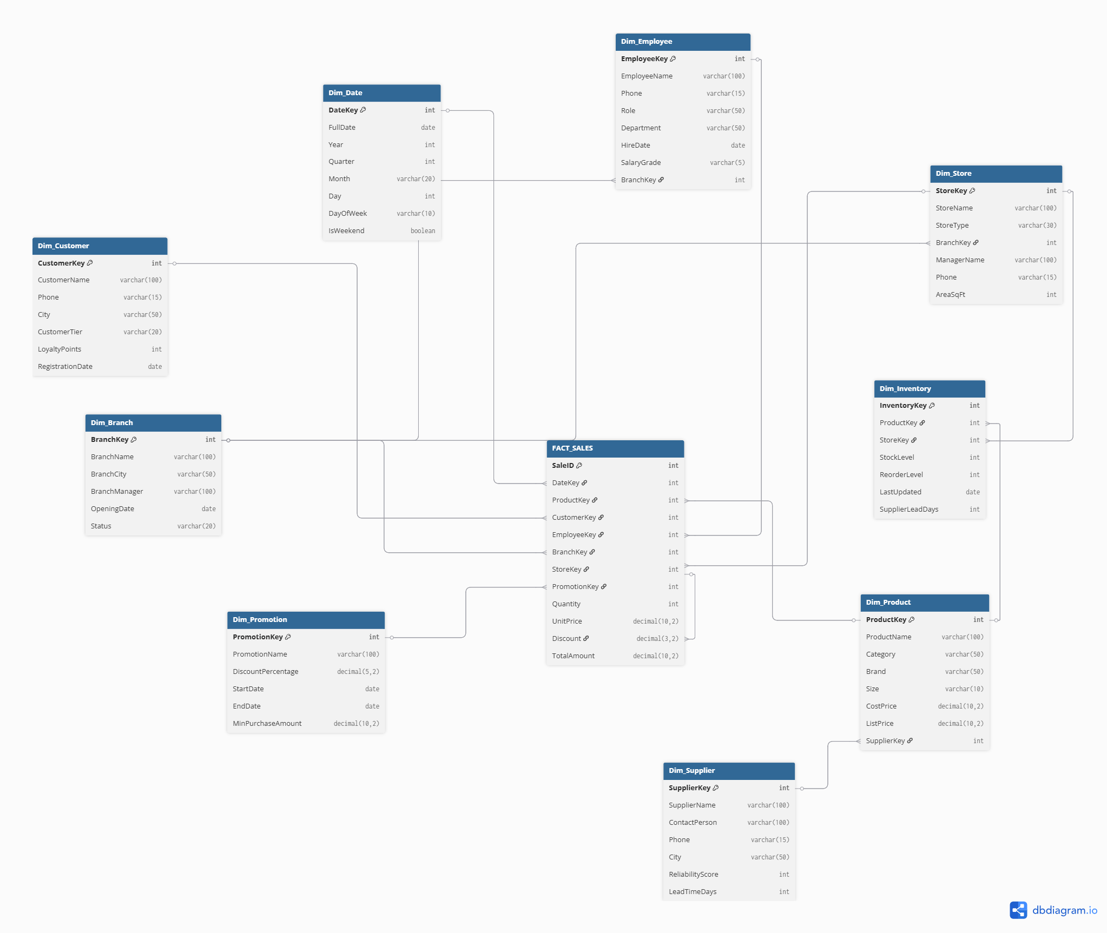
Data Modelling

Slide 17
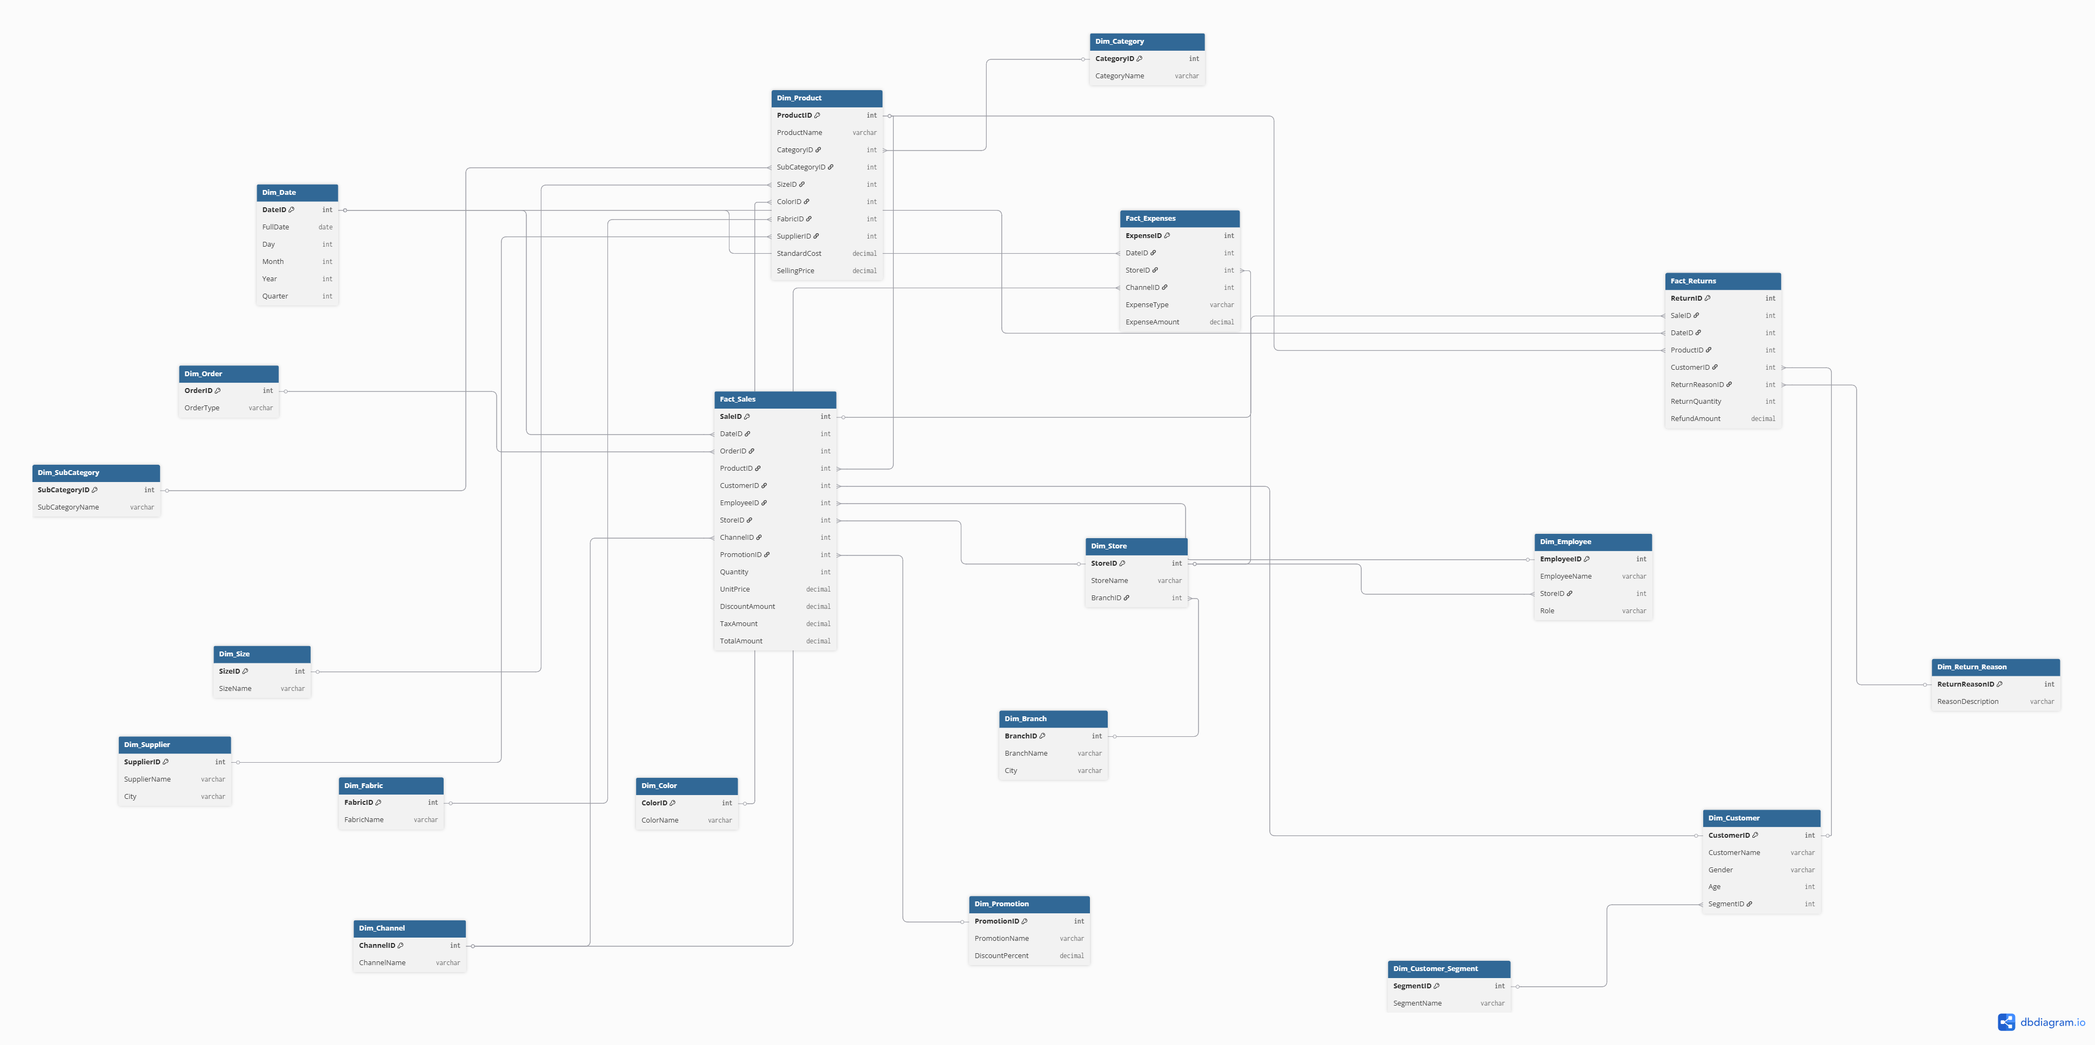
Data Modeling

Slide 18
Key Performance Indicators
1. Total Revenue
Formula: SUM(Sales Amount) About: Total income generated from all sales.
2.Net Profit Margin
Formula: (Net Profit / Total Revenue) × 100 About: Measures overall profitability percentage.
3.Gross Margin
Formula: (Revenue – Cost of Goods Sold) / Revenue × 100 About: Shows profit before operational expenses.

Slide 19
Key Performance Indicators
4. Sales per Store
Formula: Total Revenue / Number of Stores About: Measures store performance efficiency.
5. Sales per Employee
Formula: Total Revenue / Number of Employees About: Evaluates employee productivity.
6. Month-over-Month (MoM) Growth
Formula: ((Current Month Sales – Previous Month Sales) / Previous Month Sales) × 100 About: Tracks monthly sales growth trend.

Slide 20
Key Performance Indicators
7. Inventory Turnover Ratio
Formula: Cost of Goods Sold / Average Inventory About: Indicates how efficiently inventory is sold.
8. Stockout Rate
Formula: (Stockout Days / Total Selling Days) × 100 About: Measures frequency of product unavailability.
9. Customer Retention Rate
Formula: ((Customers at End – New Customers) / Customers at Start) × 100 About: Shows how well the business retains customers.
10. Return Rate
Formula: (Returned Items / Total Items Sold) × 100 About: Measures product return percentage.

Slide 21
Reference Datasets
The following open-source datasets were referred to for understanding structure, attributes, and retail sales patterns:
1. Online Retail Dataset (Transactions)
Kaggle Link: https://www.kaggle.com/datasets/ulrikthygepedersen/online-retail-dataset Includes transactional sales data such as product code, description, quantity, price, date/time, customer ID, and country — great for sales and inventory references.
2. H&M Ecommerce Products Dataset (Enhanced Version on Hugging Face)
Hugging Face Link: https://huggingface.co/datasets/nleroy917/hm_ecommerce_products Contains rich product metadata, customer info, sales transaction history and image URLs — useful for multi-attribute retail structure reference.
3. Women Fashion Trend Dataset (Kaggle)
Link : https://baselight.app/u/kaggle/dataset/durgeshrao9993_dataset Includes ~43 columns covering price, ratings, inventory counts, colors, tags, merchant info, and trends — good for product and trend analysis reference.

Slide 22
Business Impact & Value Delivered
Faster and automated sales reporting
Improved inventory planning and reduced stockouts
Better understanding of customer buying behavior
Store and employee performance visibility
Data-driven decision-making instead of manual analysis

Slide 23
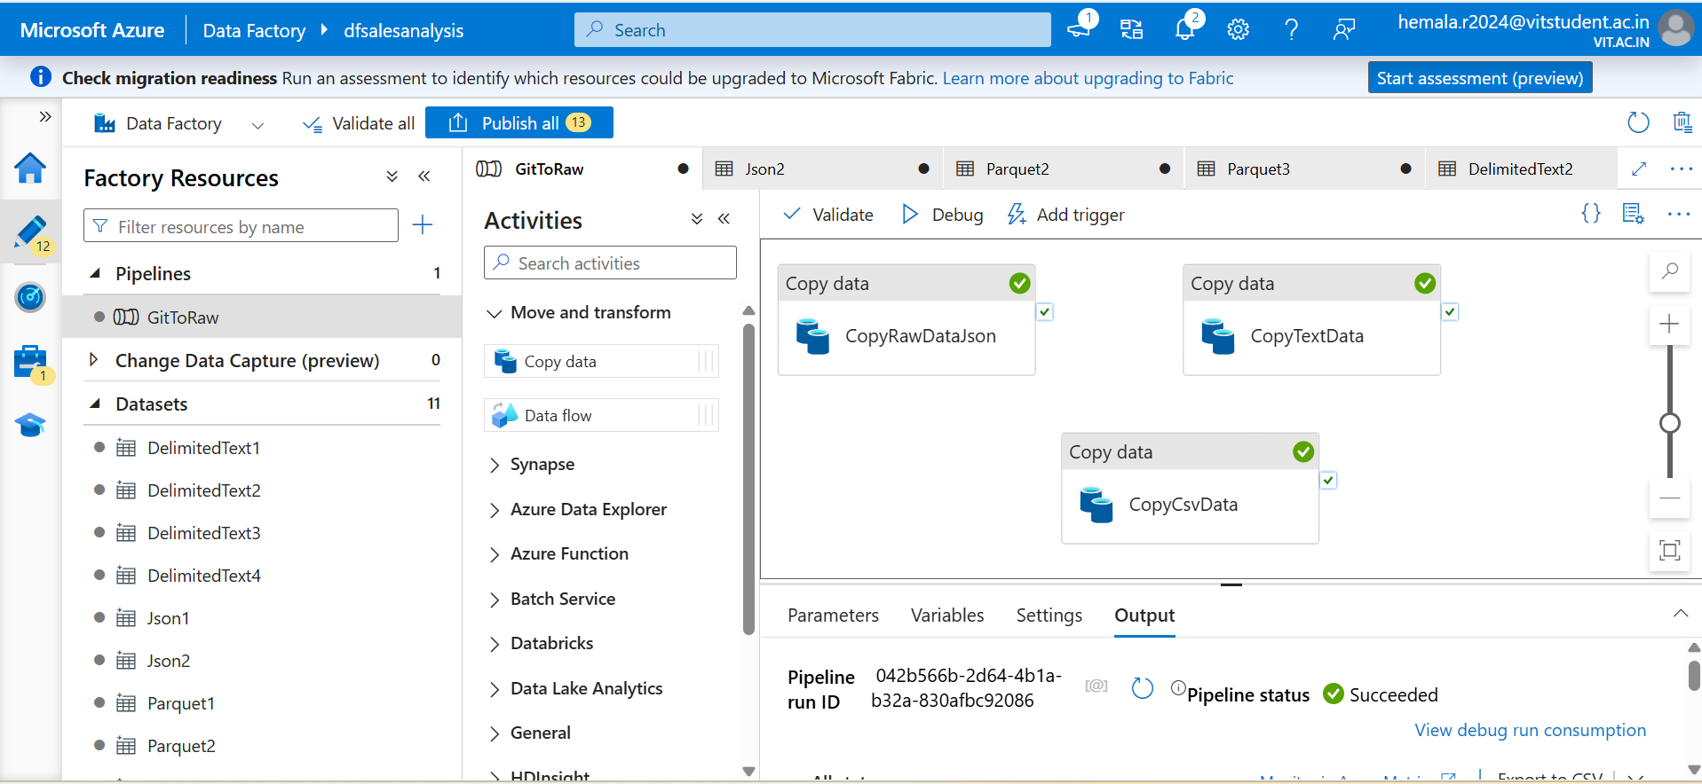
Copy Activity for all file formats

Slide 24
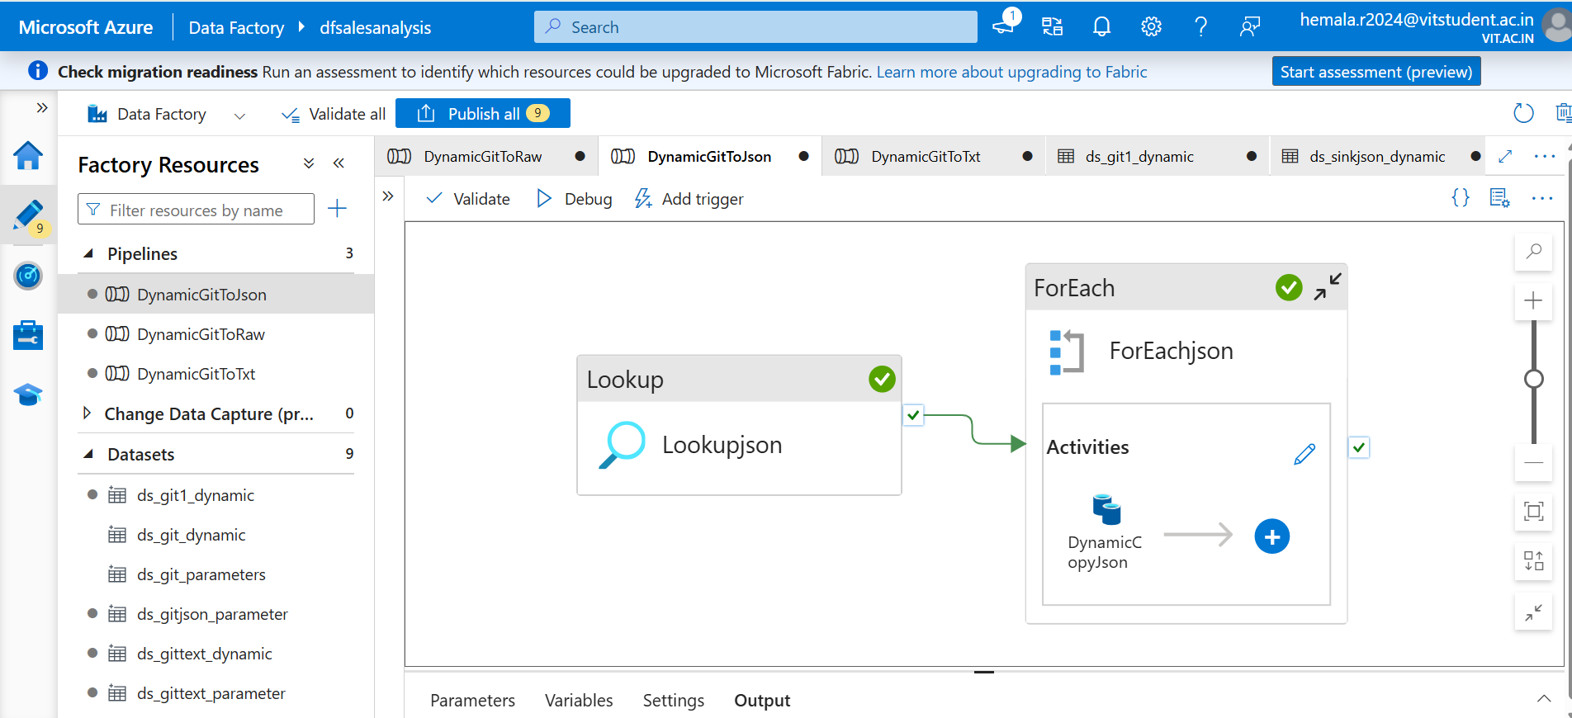
Pipeline to process Json file

Slide 25
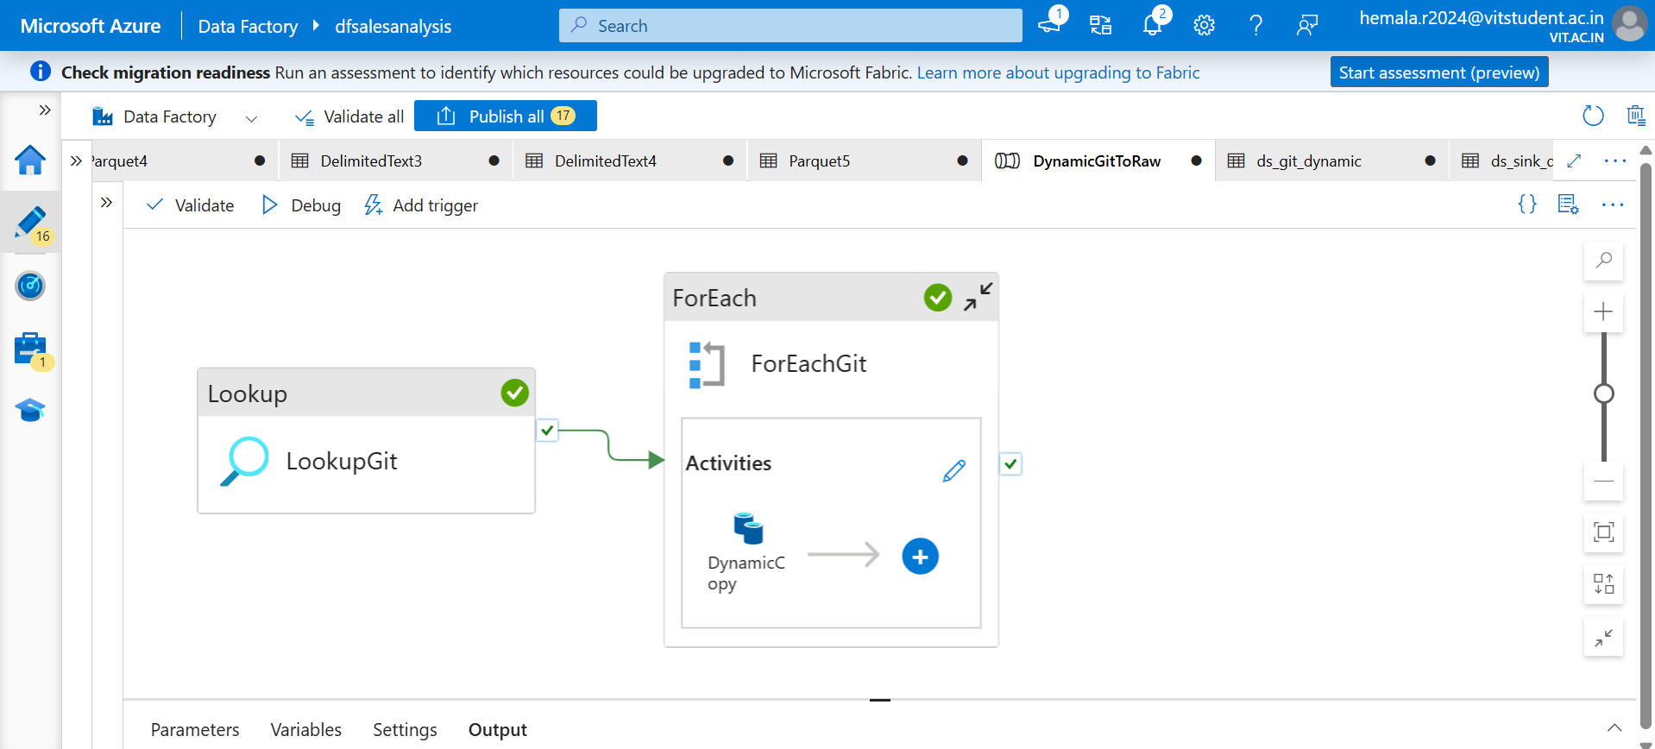
Pipeline to process CSV file

Slide 26
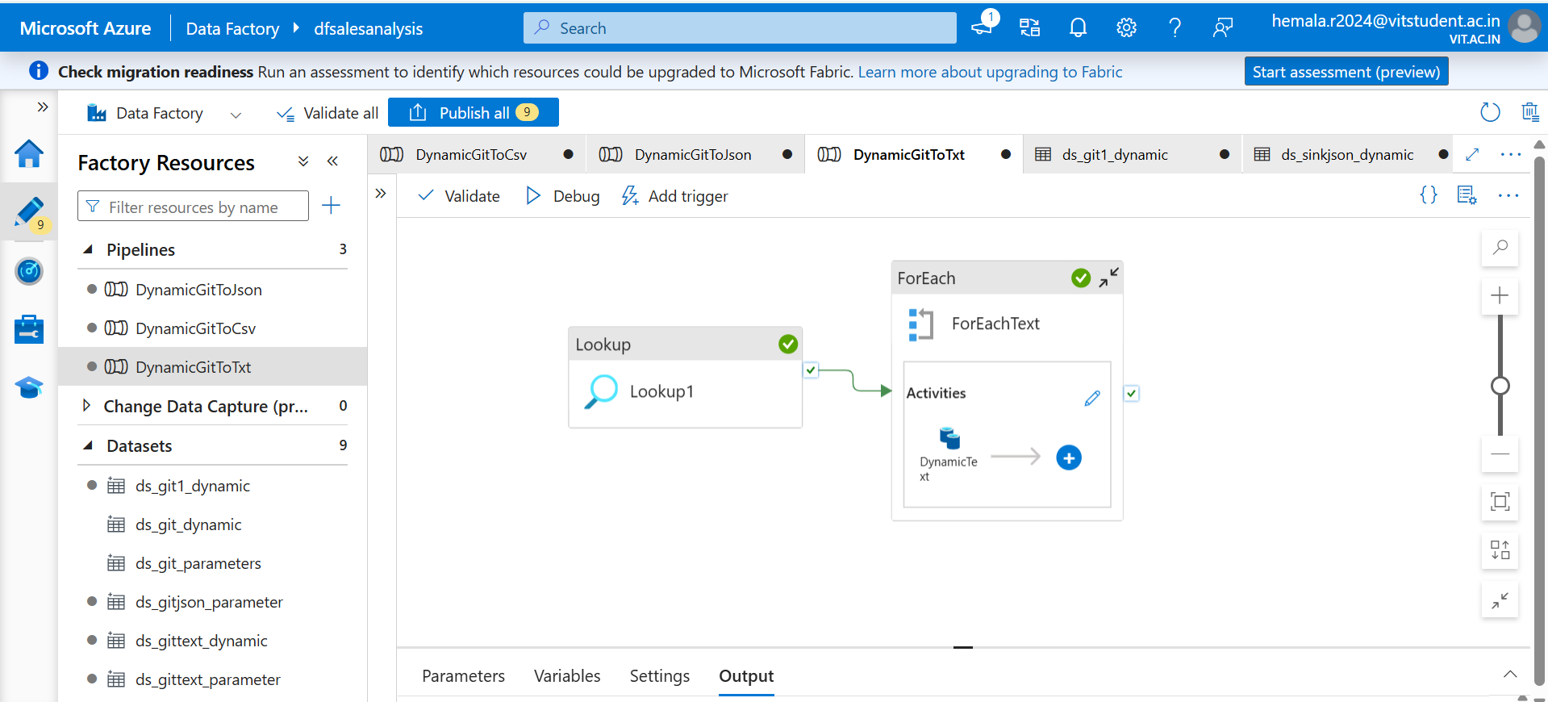
Pipeline to process text file

Slide 27
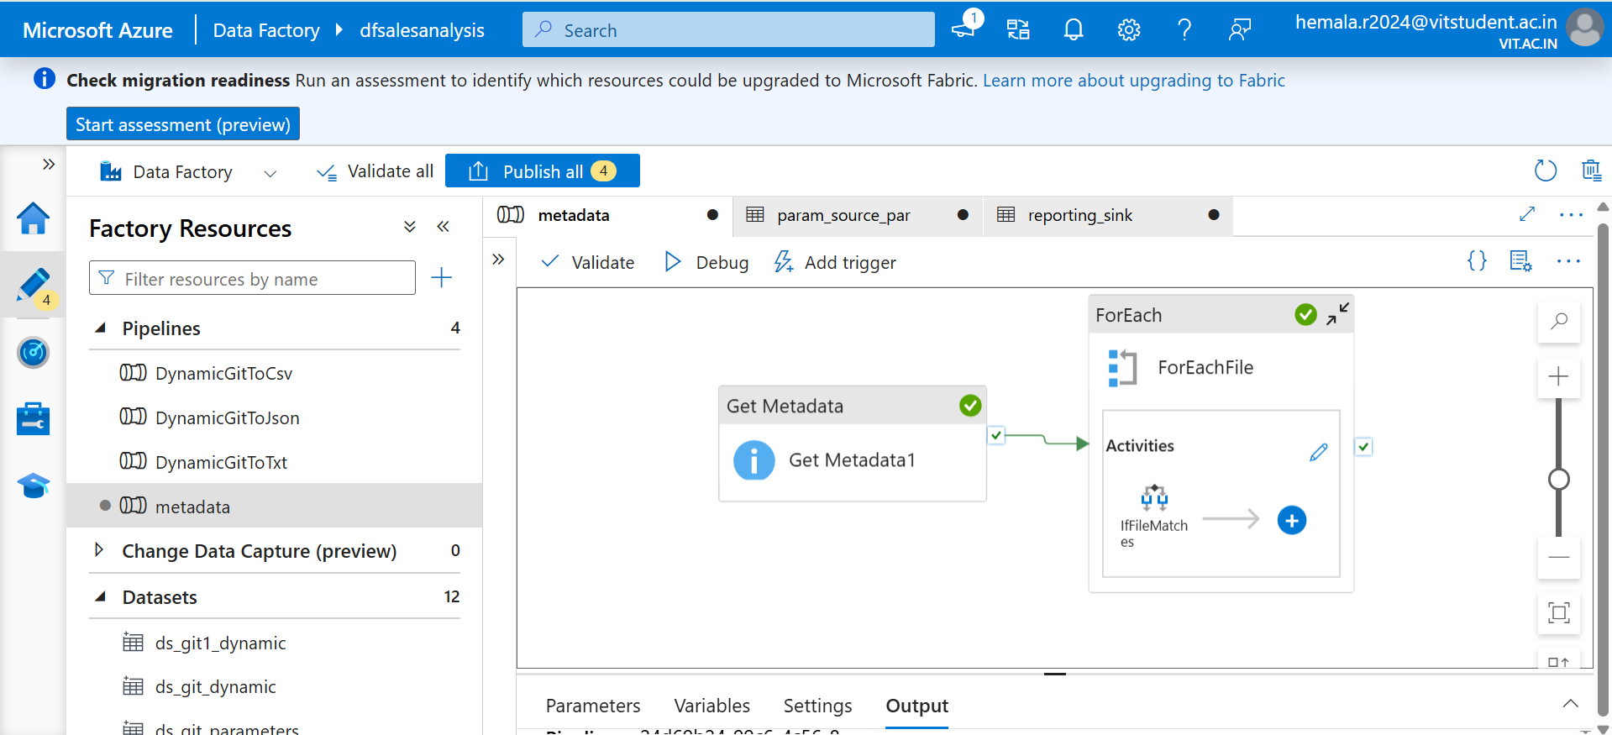
Pipeline for Metadata processing

Slide 28
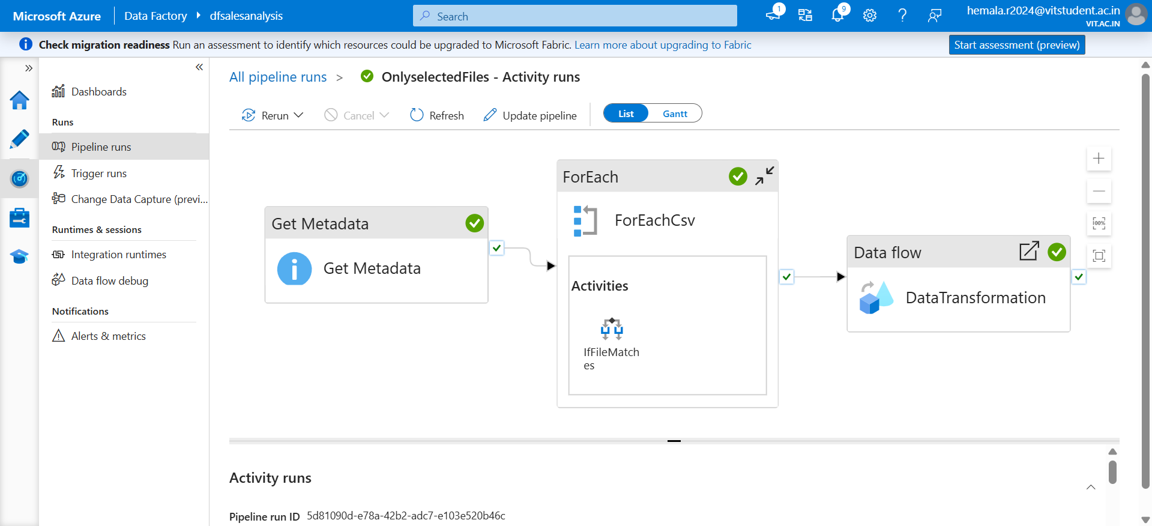
Data Transformation using Data flow

Slide 29
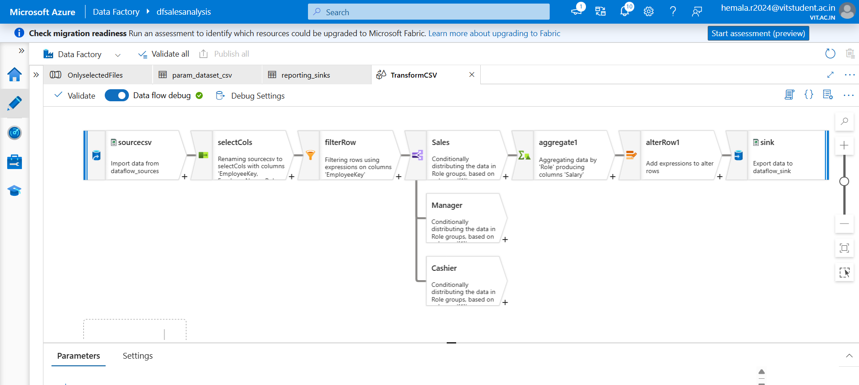
Data Transformation using Data flow

Slide 30
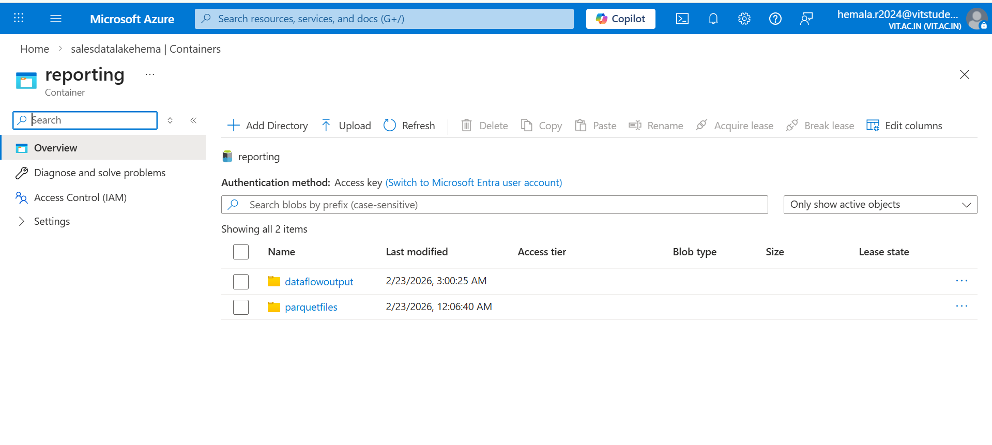
Data loaded after transformation to the sink

Slide 31
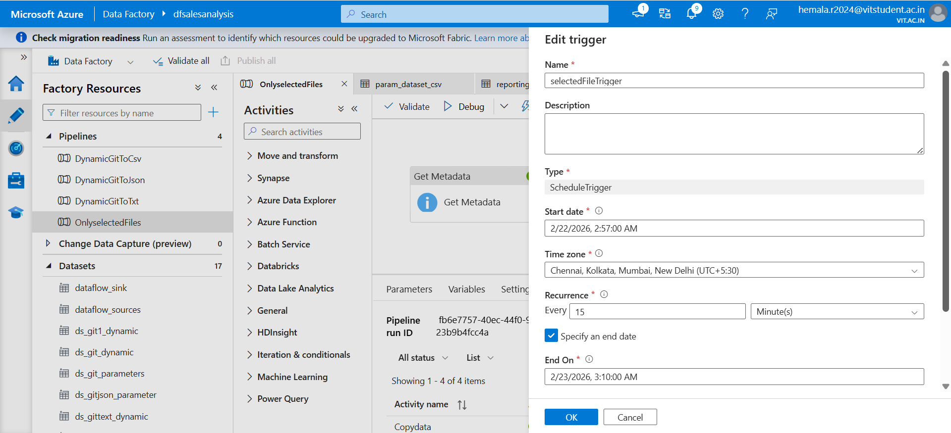
Creating new trigger

Slide 32
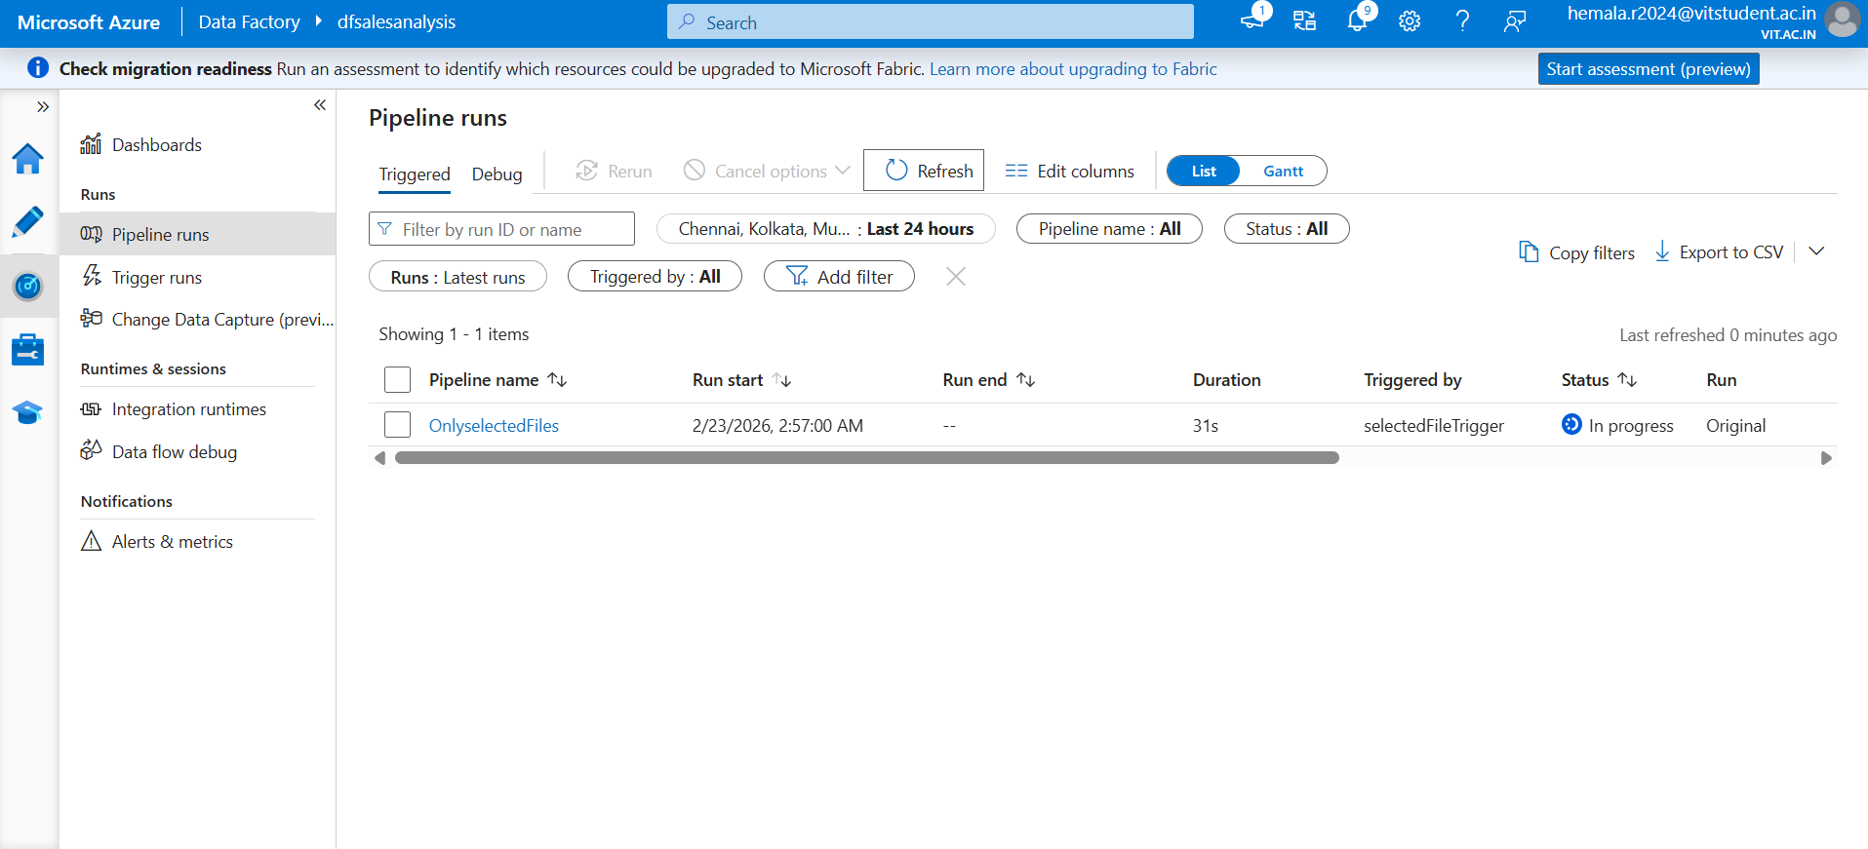
Pipeline Run using Trigger

Slide 33

Pipeline Run using Trigger

Slide 34


